Slide 1
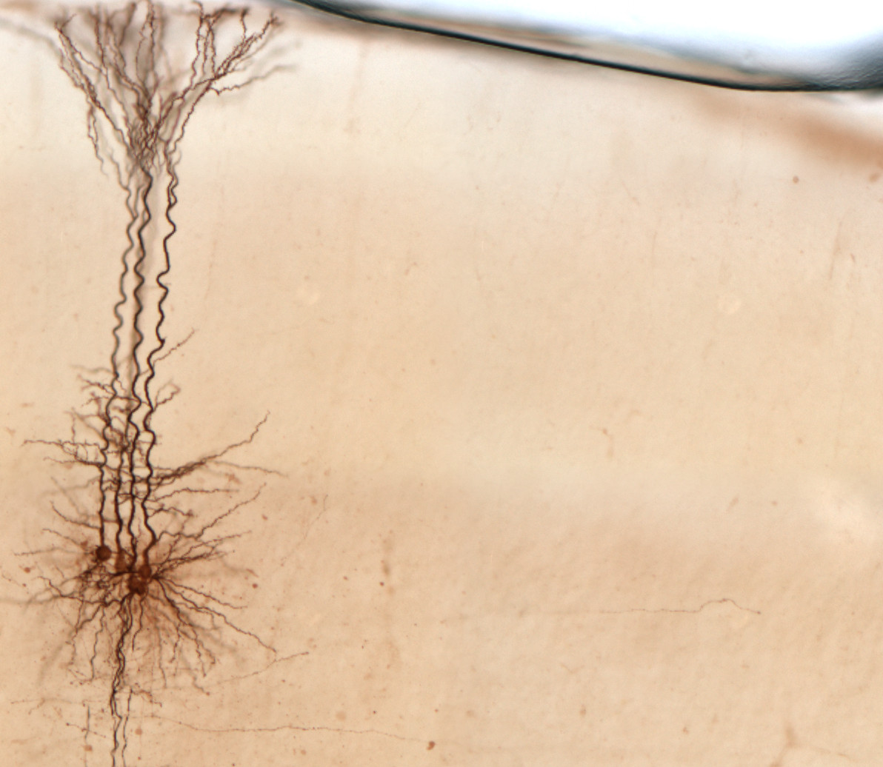
Neuroelectronics: Ions, membranes and spikes
Joseph Raimondo - isiCNI2020

Slide 2
Ask lots of questions!!!
You will get a lot of information.
Much of it will be completely unfamiliar.
It will be very easy to get lost!
If you have a question, the odds are somebody else will have the same question, so please ask it.
The chances of asking a stupid question are small.
Faculty tend to overestimate the ability of students to absorb material.
If all else fails, bug your TAs and/or other students for explanations.
Notes:
update first homework

Slide 3
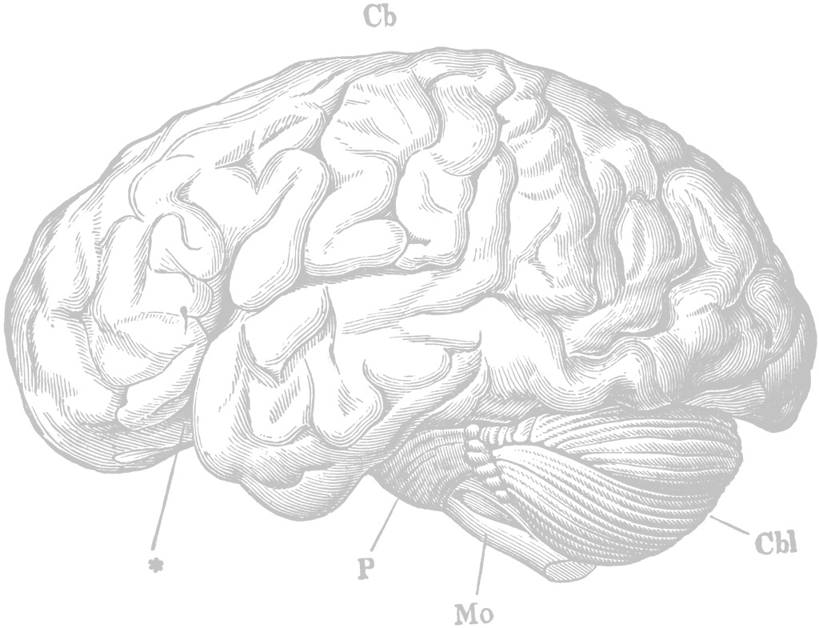
Neuroscience: why should you care?
Understand ourselves
Build intelligent systems to make the world better
Treat disease

Slide 4
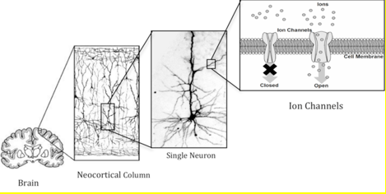
Your brain
whole brain (2 kg):
10¹¹ neurons
10¹⁴ connections
8 million km of axons
20 watts
whole CPU:
10⁹ transistors
2×10⁹ connections
2 km of wire
scaled to brain: MWs

Slide 5
Marr’s levels of analysis
Computational level
What do brains do and why? What problems do they solve?
Algorithmic level
How are these problems solved? What algorithms are used?
Implementational level
How are these algorithms physically implemented.

Slide 6
Marr’s levels of analysis
Computational level
What do brains do and why? What problems do they solve?
Algorithmic level
How are these problems solved? What algorithms are used?
Implementational level
How are these algorithms physically implemented.

Slide 7
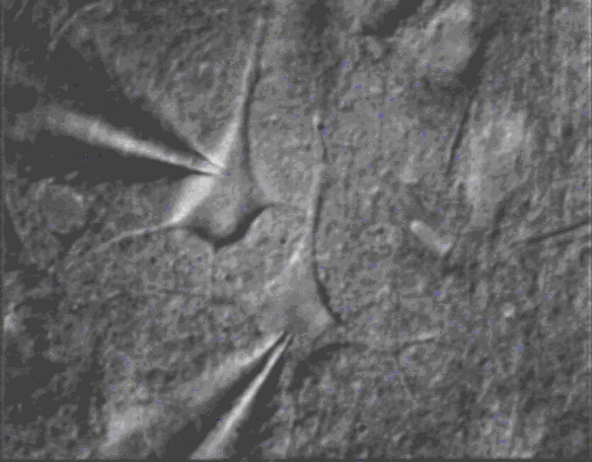
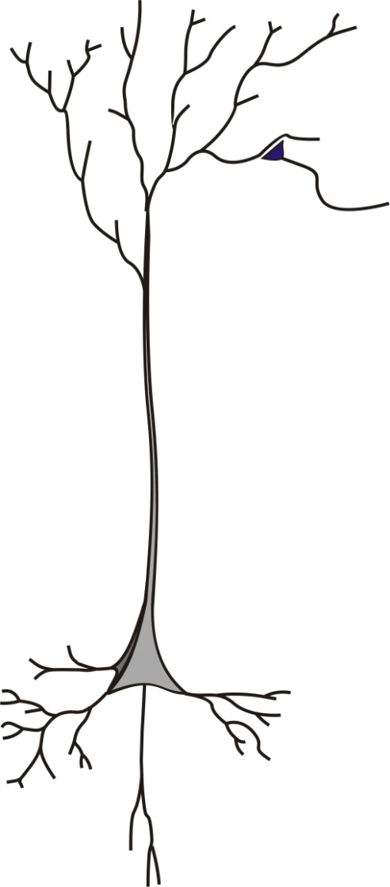
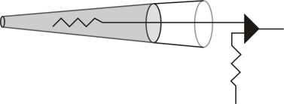
Dogma:
The neuron is the basic computational unit of the brain
Glass
electrode

Slide 8
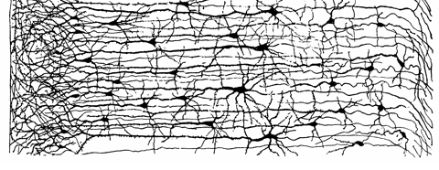
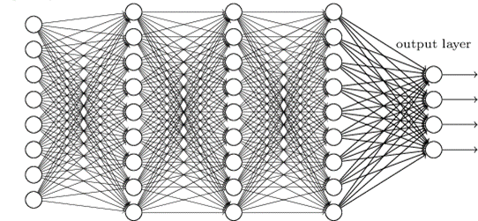
The ‘neuron’ is the basic building block of a network
‘real’ neural network
artificial neural network

Slide 9
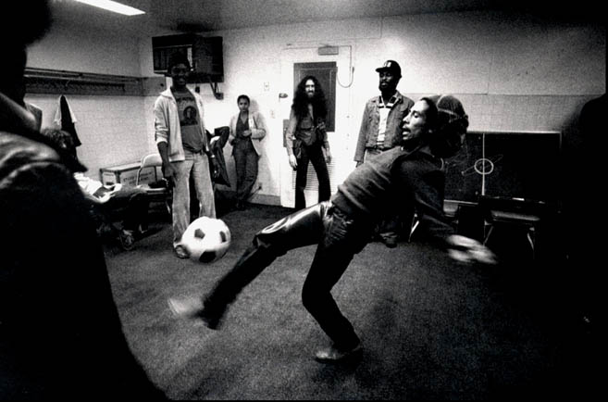
Neurons are fundamental to…
pretty much everything that makes us human.

Slide 10
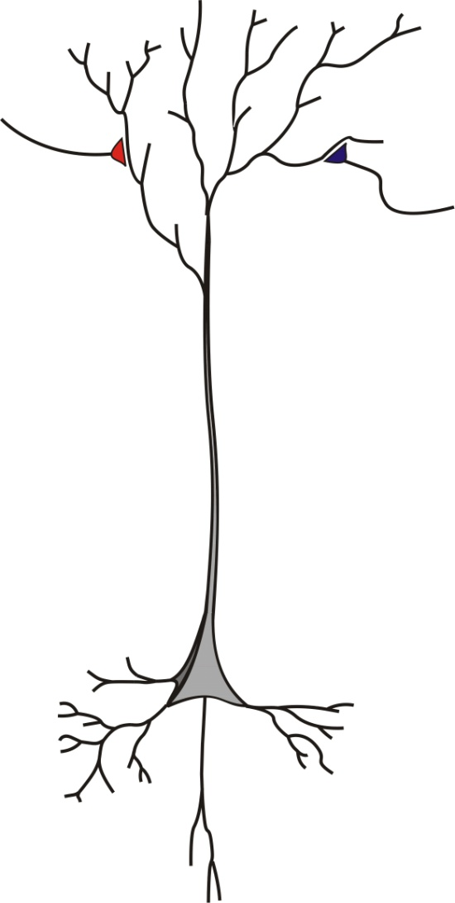
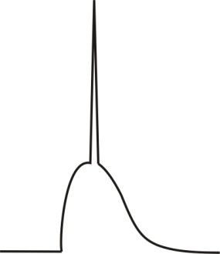
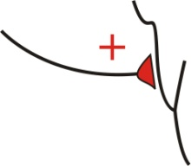
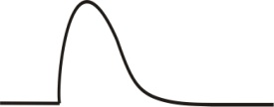

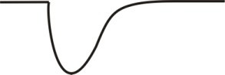
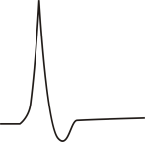
How do neurons work?
How do they compute?
(bit easier than how brains compute)
+
=
-70 mV
+
=
-70 mV

Slide 11
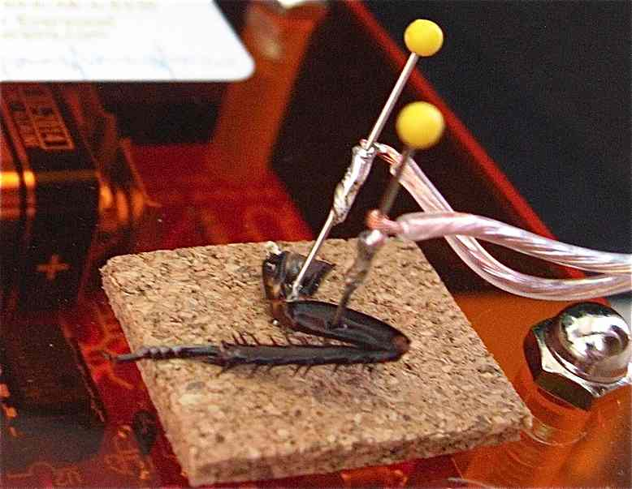
Lecture Outline
Transmembrane ion movement and RC circuits
The membrane potential at rest
Action potentials

Slide 12
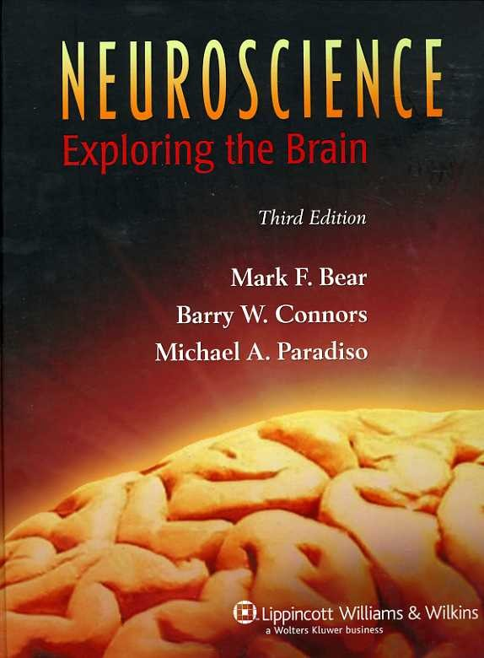
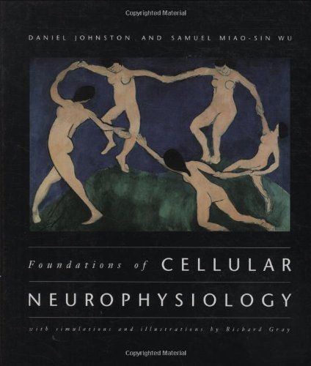
Useful textbooks.
Very accessible.
Bit more hardocre.

Slide 13
Lecture Outline
Transmembrane ion movement and RC circuits
The membrane potential at rest
Action potentials
Note: a lot of this is based on Adrienne Fairhall’s
Lecture “Modelling Neurons and Spikes” from her excellent Coursera course – Computational Neuroscience

Slide 14


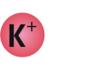
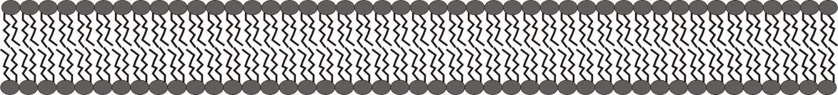
The actors: ions, membranes, channels
Phospholipid
bilayer
Ions
Outside cell
Ion channels
Inside cell

Slide 15
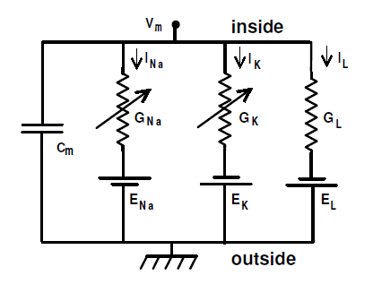
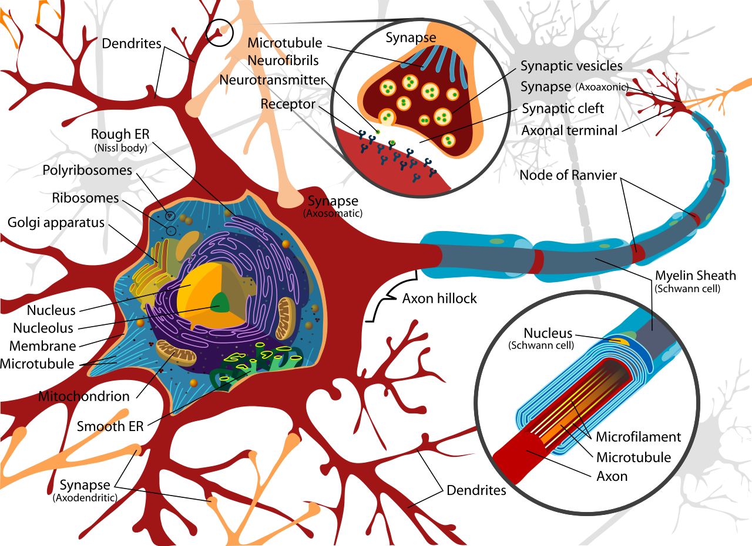
Equivalent circuit models help us describe how neurons compute
Dendrites
Axon

Slide 16
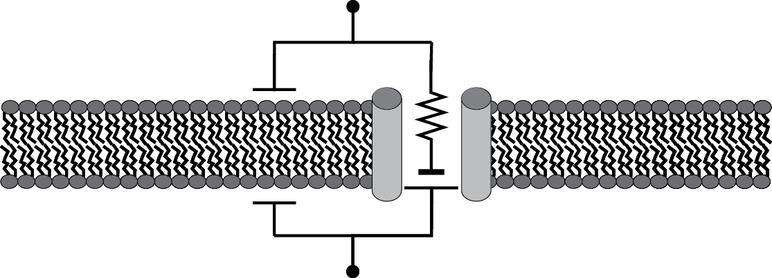
Equivalent circuit models help us describe how neurons compute
Phospholipid
bilayer
Ion channels
Outside cell
Inside cell
Voltage / potential difference - ‘electric pressure’
Current - flow of charge per unit time

Slide 17
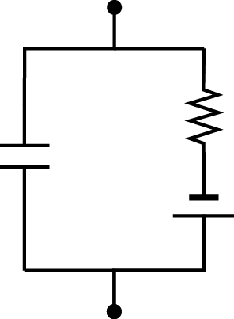
RC circuits
I_{ext}
Some rules:
Across a wire the voltage doesn’t change
The current (flow of charge) into an element must equal the current flowing out
At a junction of wires the total current is zero (Kirchoff’s Current Law)
The voltage changes by a fixed amount across a battery (voltage source)
The voltage changes by a variable amount across a resistor according to Ohms law: V= IR (I = gV)
R
C
E

Slide 18
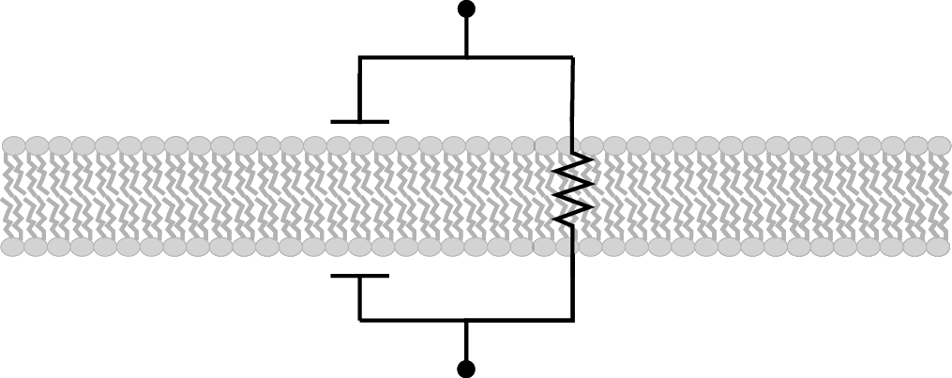
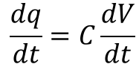
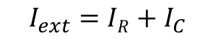
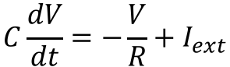
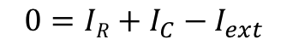
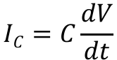
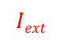
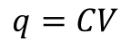
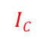
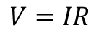
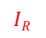
Modeling the membrane as an RC circuit (no channels yet)
$$Iext$$
Outside cell
$$IC$$
$$IR$$
C
R
V?
Inside cell
Kirchoff’s current law:
$$I_{ext}=IR+I_{C}$$
or
$$0=IR+I_{C}−I_{ext}$$
Ohm’s law:
$$V=IR$$
Capacitance:
$$\frac{dq}{dt}=C\frac{dV}{dt}$$
$$q=CV$$
$$IC=C\frac{dV}{dt}$$
$$C\frac{dV}{dt}=−\frac{V}{R}+I_{ext}$$

Slide 19
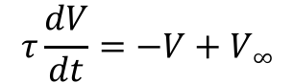
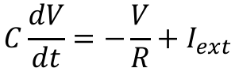
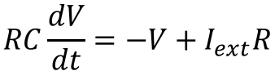
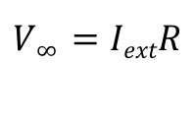
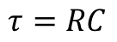
Modeling the membrane as an RC circuit (no channels yet)
$$Iext$$
Outside cell
$$IC$$
$$IR$$
C
R
V?
Inside cell
$$C\frac{dV}{dt}=−\frac{V}{R}+I_{ext}$$
$$RC\frac{dV}{dt}=−V+I_{ext}R$$
Membrane
time constant
$$τ\frac{dV}{dt}=−V+V∞$$
$$τ=RC$$
Steady state
voltage
$$V∞ =IextR$$

Slide 20
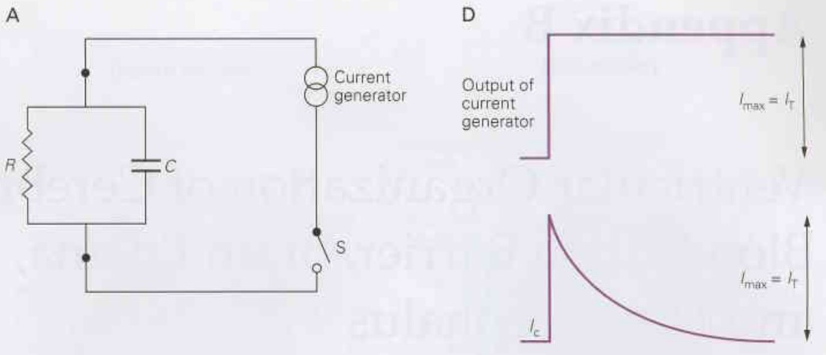
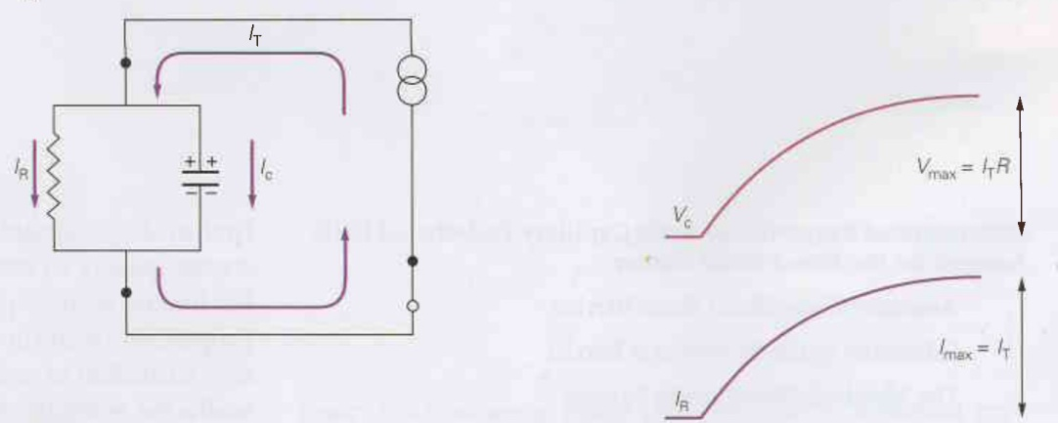
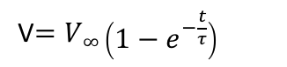
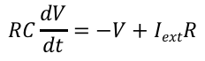

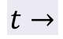
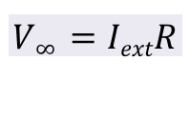
I_{ext}
Max I_{C} = I_{ext}
I_{C}
I_{ext}
V$=V∞\left(1−e^{−\frac{t}{τ}}\right)$
I_{R}
I_{C}
$$V∞ =IextR$$
V
Max I_{R} = I_{ext}
$$RC\frac{dV}{dt}=−V+IextR$$
I_{R}
$$τ\frac{dV}{dt}=−V+V∞$$
$$t→$$

Slide 21
Neurons have a ‘battery’ thanks to transmembrane ion gradients
Outside cell: High Na⁺, Cl⁻, Ca²⁺
Ion channels
Inside cell: High K⁺

Slide 22
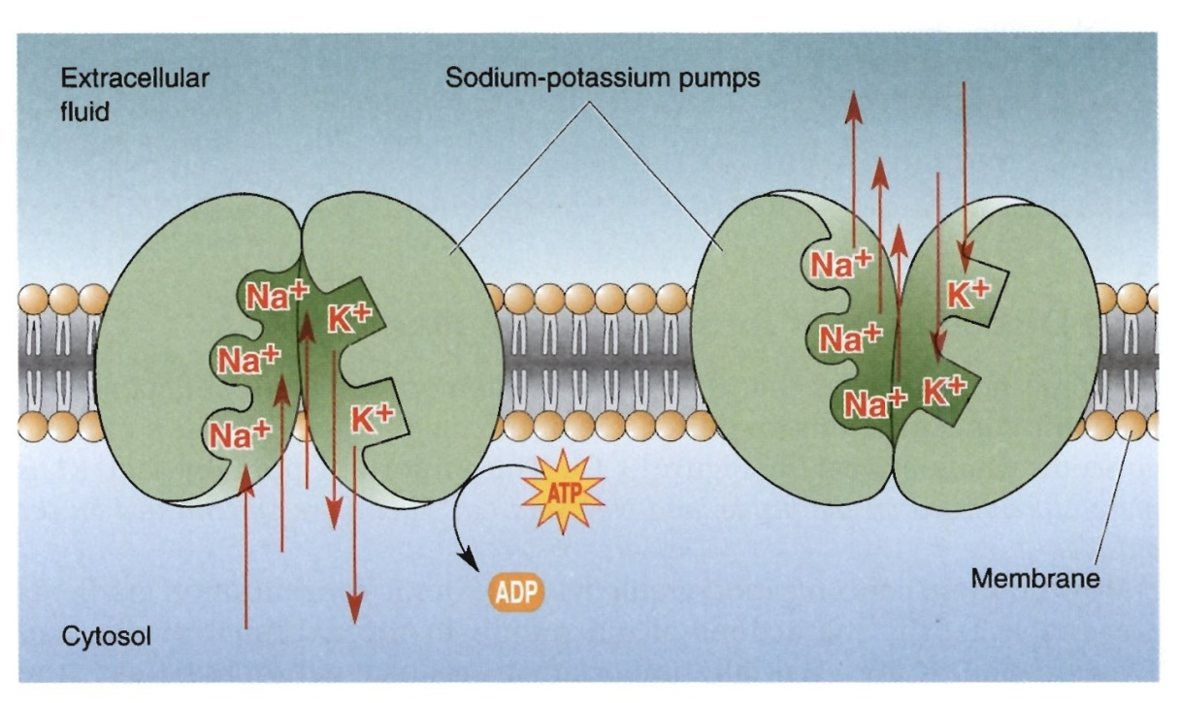
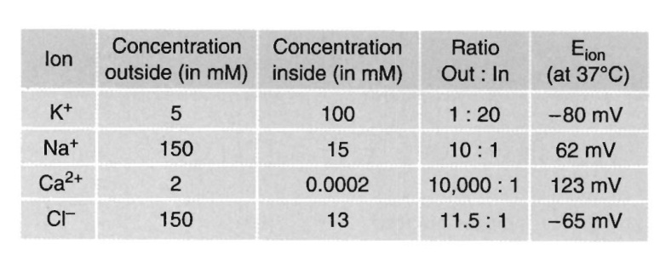
What establishes the transmembrane gradient of ions?
Anything weird?
(charge balance)
Not showing all the intracellular impermeant anions (DNA, metabolites, proteins ~100 mM)

Slide 23
Consider our ancestors: a cell floating in the sea
The cell membrane separates ’self’ from everything else
Impermeant ions:
(mostly anions)
e.g. proteins
DNA
metabolites
Permeant
ions Na+, K+, Cl- (outside)
Permeant
ions e.g. Na+, K+, Cl- (inside)
H₂0
Water will enter the cell
by osmosis
[Impermeants] + [Permeants (inside)] > [Permeants (outside)]

Slide 24
POP!!!
Impermeant ions:
e.g. proteins
DNA
metabolites
Permeant
ions (inside)
Permeant
Ions (outside)
H₂0
[Impermeants] + [Permeants (inside)] > [Permeants (outside)]

Slide 25
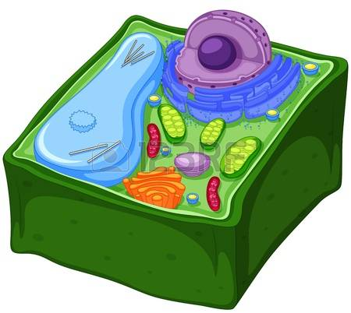
The Na+ / K+ ATPase prevents cells from swelling by pumping Na+ out of the cell
‘self’
Cell wall
Impermeant ions:
e.g. proteins
DNA
metabolites
Permeant
ions (inside)
Permeant
Ions (outside)
Plant cell
Na+
Na+ / K+ ATPase
Na+ becomes
‘functionally’
impermeant
H₂0
H₂0
[Impermeants] + [Permeants (inside)] = [Permeants (outside)]

Slide 26
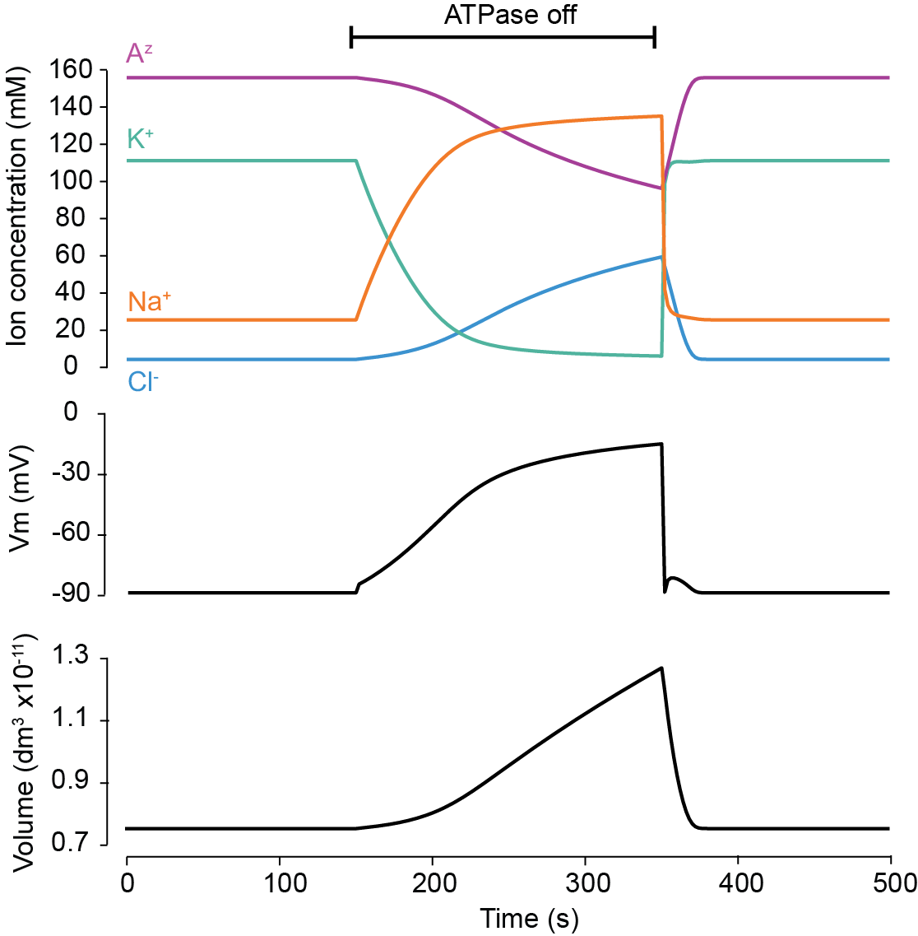

The Na⁺/K⁺ ATPase prevents cells exploding and in so doing establishes ion gradients (and Vm)
Dursterwald et al. (2018) eLife
Kira Dusterwald

Slide 27
Neurons have a ‘battery’ thanks to transmembrane ion gradients
Outside cell: High Na⁺, Cl⁻, Ca²⁺
Ion channels
E
Inside cell: High K⁺
How do we calculate E?
(also known as an
equilibrium potential)

Slide 28
Ions move across the membrane via 2 processes
1) Diffusion, which pushes an ion down its concentration gradient
2) Electrostatic forces, which causes an ion to be attracted to opposite charges and repelled by like charges.

Slide 29




How do ions move across the membrane? Diffusion
Fick’s Law of Diffusion
Ions move down their
concentration gradient
$$Jdiff=−D\frac{Δ[C]}{Δx}$$
Flux of ions
Diffusion coefficient
Concentration Gradient

Slide 30




How do ions move across the membrane? Electrostatic force
No current
Ionic current
Ohms Law
$$Jdrift =E/p$$
$$I=V/R$$
Flux of ions
Electric field
Resistivity

Slide 31




Equilibrium potentials and the Nernst Equation
100 mM
5 mM
99.9999 mM
5.00001 mM
V_{in} - V_{out} = 0 mV
V_{in} - V_{out} = -30ish mV
V_{in} - V_{out} = -80 mV
No net flux of K⁺
$$Jdiff=J_{dr}ift$$
Notes:
1)The equilibrium potential for a particular ion is the electrical potential difference / voltage across the membrane which exactly counters the tendency of that ion to move down its concentration gradient.
2) For a given equilibrium potential ions will move in order to drive the membrane potential toward the equilibrium potential
3) Large changes in membrane potential are caused by miniscule changes in ionic concentration (for a 50 µm diameter cell going from 0 to -80 mV used 0.00001 mM K⁺)

Slide 32
Equilibrium potential (also called reversal potential)
1)The equilibrium potential for a particular ion is the electrical potential difference / voltage across the membrane which exactly counters the tendency of that ion to move down its concentration gradient.
2) A given ion will move in order to drive the membrane potential toward its equilibrium potential.

Slide 33



Nernst equation
From $Jdiff=J_{drift}$ one can derive the Nernst equation
Ie. The Nernst equation allows one to determine the equilibrium potential for an ion.
Inside cell
Outside cell
$E_{K}=V_{in} −V_{out}$ = $\frac{RT}{zF}\ln{\frac{\left[K^{+}\right]out}{\left[K^{+}\right]in}}$
$$E_{K}=\frac{(8.31)(37+273)}{(1)(9.6x104)}\ln{\frac{5}{100}}$$
$$E_{K}=−80.3 mV$$
Equilibrium or Reversal Potential
Concentration Gradient

Slide 34












Ohms law:
$$V_{Ri}=I_{i}R$$
$$I_{i}= \frac{V_{Ri}}{R}$$
$$V_{Ri}$$
$$I_{i}$$
$$I_{i}=gV_{Ri}$$
$$V$$
$$E_{i}$$
$$V=V_{Ri}+E_{i}$$
$$I_{i}=g_{i}(V −E_{i})$$
Ions are move across the membrane at a rate proportional to the difference between the membrane potential and the equilibrium potential (driving force)
‘Modified’ ohms law
Nernst equation
$$E_{i}= \frac{RT}{zF}ln\frac{{\left[C\right]}_{out}}{{\left[C\right]}_{in}}$$
$$I_{i}=g_{i}(V −E_{i})$$
Ionic current
Driving Force
Conductance ($g_{i}=1/{R_{i}})$
Equilibrium potential

Slide 35

At this point there is no net flux of K+

Slide 36
Lecture Outline
Lecture 1:
Transmembrane ion movement and RC circuits
The membrane potential at rest
Action potentials

Slide 37

Resting membrane potential

Slide 38






Outside cell
$$Iext$$
$$ICm$$
$$Ii$$
g_{i}
Cm
V?
E_{i}
Inside cell
$$0=ICm+\sum_{i}{Ii} −Iext$$
$$Cm\frac{dV}{dt}=−{\sum_{i}{g_{i}\left(V −E_{i}\right)+Iext}}_{}$$
At rest: $\frac{dV}{dt}$ = 0 and $Iext$ = 0

Slide 39








Outside cell
g_{K}
g_{Na}
g_{Cl}
Cm
V?
E_{K}
E_{Na}
E_{Cl}
Inside cell
$$0=ICm+I_{K}+I_{Na}+I_{Cl}− Iext$$
$$Cm\frac{dV}{dt}=−g_{K}\left(V −E_{K}\right)−g_{Na}\left(V −E_{Na}\right)−g_{Cl}\left(V −E_{Cl}\right)+Iext$$
At rest: $\frac{dV}{dt}$ = 0 and $Iext$ = 0
$$E_{K} \sim −80 mV$$
$$Vrest={\frac{gK{(E}_{K})+g_{Na}(E_{Na})+g_{Cl}(E_{Cl}) }{gK+g_{Na}+g_{Cl}}}_{}$$
$$E_{Na} \sim 62 mV$$
$$E_{Cl} \sim −65 mV$$
At rest:
$$V_{rest} \sim −65 mV$$
$$g_{K}≫g_{Na} , g_{Cl}$$
What about impermeant anions?
– they have no conductance

Slide 40


Another way to calculate V
$$V= \frac{q}{C_{m}}$$
total intracellular charge
membrane capacitance
Concentration of all the ions in the cell (hard to keep track of)
$$V= \frac{F ({{[Na}^{+}]}_{i}+{{[K}^{+}]}_{i}−{{[Cl}^{−}]}_{i}+z{{[X}^{z}]}_{i}) }{C_{m}}$$
Impermeant anions

Slide 41
Lecture Outline
Lecture 1:
Transmembrane ion movement and RC circuits
The membrane potential at rest
Action potentials

Slide 42


What makes a neuron compute?
$$Cm\frac{dV}{dt}=−{\sum_{i}{g_{i}\left(V −E_{i}\right)+I_{ext}}}_{}$$
25 mV
Current inj.
50 pA

Slide 43

Action potentials emerge from ion channel nonlinearites
Outside cell
g_{K}
g_{Na}
g_{L}
Cm
E_{K}
E_{Na}
E_{L}
Inside cell

Slide 44

This is what an action potential or ‘spike’ looks like

Slide 45


Slide 46


Slide 47

Injecting current into a neuron can cause it to spike

Slide 48


Slide 49

Mechanisms of action potential generation

Slide 50

Mechanisms of action potential generation

Slide 51

Molecular basis of action potentials

Slide 52




Alan Hodgkin
Andrew Huxley
Poser
Nobel Prize 1963 "for their discoveries concerning the ionic mechanisms involved in excitation and inhibition in the peripheral and central portions of the nerve cell membrane".

Slide 53






Voltage gated K⁺ channels
K+ channel: ‘voltage sensor’
gate
$n$ is the probability a single ‘subunit’ Is open
$1−n$ is the probability a subunit is closed
$$P_{K}\sim n4$$
Transitions between states occur at voltage
dependent rates:
$∝n(V)$ Rate of going from Closed -> Open
$βn(V)$ Rate of going from Open -> Closed
$∝n(V)$
open
closed
n
1-n
$$\frac{dn}{dt}=∝n\left(V\right)\left(1−n\right)−βn(V)\left(n\right)$$
added
to open state
lost from
open state
$$βn(V)$$

Slide 54




Voltage gated K⁺ channels
$$\frac{dn}{dt}=∝n\left(V\right)\left( 1−n\right)−βn(V)\left(n\right)$$
We can rewrite this in the following form:
$$τn(V)\frac{dn}{dt}=n∞(V)+n$$
Where:
$$τn(V) =\frac{1}{∝n\left(V\right)+βn(V)}$$
How fast it
gets there
$$n(V)∞=\frac{∝n\left(V\right)}{∝n\left(V\right)+βn(V)}$$
Where each
‘n’ is going (ie steady state
at that voltage)

Slide 55





Voltage gated Na⁺ channels
Na+ channels have 2 gates:
activation gate
$m$
inactivation gate $h$
Increase in voltage
increases $m$
but decreases $h$
$$P_{Na}\sim m3h$$

Slide 56





Voltage gated K+ channel:
$$\frac{dn}{dt}=∝n\left(V\right)\left( 1−n\right)−βn(V)\left(n\right)$$
$$\frac{dm}{dt}=∝m\left(V\right)\left(1−m\right)−βm(V)\left(m\right)$$
Voltage gated Na+ channel:
$$\frac{dh}{dt}=∝h\left(V\right)\left(1−h\right)−βh(V)\left(h\right)$$
Will get equivalent forms for $m$ and $h$ as we did for $n$
$$τn(V)\frac{dn}{dt}=n∞(V)+n$$
Ie $τm, m∞$ and $τh, h∞$
$$gK\left(V\right)=\overline{gK}n4$$
We get our voltage dependent
conductances:
$$gNa\left(V\right)=\overline{gNa}m3h$$

Slide 57


Putting it all together together
Outside cell
g_{K}
g_{Na}
g_{L}
Cm
E_{K}
E_{Na}
E
Inside cell
Kirchoff’s current law:
$$0=ICm+\sum_{i}{Ii} −Iext$$
Ohm’s law:
$$Cm\frac{dV}{dt}=−{\sum_{i}{g_{i}\left(V −E_{i}\right)+I_{ext}}}_{}$$
Capacitive current
Ionic currents
External applied current

Slide 58



Hodgkin Huxley equations in all their glory
$$Cm\frac{dV}{dt}=−\overline{gK}n4\left(V −E_{K}\right)−\overline{gNa}m3h\left(V −E_{Na}\right)−g_{L}\left(V −E_{L}\right)−Iext$$
$$\frac{dn}{dt}=∝n\left(V\right)\left( 1−n\right)−βn(V)\left(n\right)$$
Voltage gated
K+ channels
$$\frac{dm}{dt}=∝m\left(V\right)\left(1−m\right)−βm(V)\left(m\right)$$
Voltage gated
Na+ channel
$$\frac{dh}{dt}=∝h\left(V\right)\left(1−h\right)−βh(V)\left(h\right)$$

Slide 59



Understanding the spike:
$$τn(V)\frac{dn}{dt}=n∞(V)+n$$
Where each
variable is going
How fast it
gets there
E_{K}
E_{Na}
$$gK\left(V\right)=\overline{gK}n4$$
$$gNa\left(V\right)=\overline{gNa}m3h$$

Slide 60
Understanding the spike:
+ve
feedback
2 ways of
truncating +ve
voltage surge

Slide 61
Putting it all together together
Outside cell
g_{K}
g_{Na}
g_{L}
Cm
E_{K}
E_{Na}
E
Inside cell
Kirchoff’s current law:
$$0=ICm+\sum_{i}{Ii} −Iext$$
Ohm’s law:
$$Cm\frac{dV}{dt}=−{\sum_{i}{g_{i}\left(V −E_{i}\right)+I_{ext}}}_{}$$
Capacitive current
Ionic currents
External applied current
Where all the action is

Slide 62

Different neuron types show different spiking properties

Slide 63

The axon hillock is the site of action potential initiation

Slide 64


Passive conduction
The length constant (λ, or lambda) is a measure of how far the voltage travels down the axon before it decays to zero. If you have a length constant of 1 mm, that means at 1 mm away from the cell body in an axon, 37% of the voltage magnitude remains

Slide 65


$$RmCm\frac{dV}{dt}=−V+I_{ext}R$$
The time constant (Τ, or tau) is similar to the length constant, but applies to time. If a voltage change is applied inside a neuron, it takes time for the neuron to fully "charge" to a stable voltage.
An "ideal neuron" would have an infinitely high length constant and an infinitely low time constant. Thus, any voltage change anywhere in the neuron would instantly change the voltage everywhere else in the neuron.

Slide 66

Active conduction

Slide 67


How the length constant affects action potential conduction velocity
Low length constant
The door is an ion channel, and the person waiting to open it is the voltage sensitive gate.
The length constant determines how far their shout ‘open’ travels.
High length constant

Slide 68

How the time constant affects action potential conduction velocity
Low time constant
Adding myelin reduces Cm
Ie faster conduction
High time constant
A high time constant means it takes a while to shout ‘open!’

Slide 69


Slide 70


Myelin reduces membrane capacitance
Decreased membrane capacitance. This would SPEED UP action potential propagation.

Slide 71


Myelin increases membrane resistance
Increased membrane resistance. This would SPEED UP action potential propagation.

Slide 72

Myelin speeds up action potential propagation via saltatory conduction (jumping between nodes)

Slide 73



Slide 74
Where to from RC circuits and Hodgkin Huxley?
Hodgkin Huxley
Biological realism:
Geometry
Additional channels
Synapses
Cell types etc
Ion dynamics
Simplified models:
Fundamental dynamics
Analytical tractability
e.g. leaky integrate and fire

Slide 75

Compartmental models of anatomically detailed neurons

Slide 76

String RC circuits together till you get this
String RC circuits together till you get this

Slide 77

Lecture Outline
Lecture 1:
Transmembrane ion movement and RC circuits
The membrane potential at rest
Action potentials

